Slide 1
Gym Tracker Web Application
Student Name: Oskar Grzenda
Supervisor Name: Joe Corr

Slide 2
Context & Objectives
I am creating a web application that will allow users to track their gym progress in an easy and visual way
I am creating a web application as that is something I have an interest in and would like to potentially pursue a career in this area in the future
Key Objectives
Enhance my web development skills
Learn more about React
Have a project that I can showcase at interviews

Slide 3
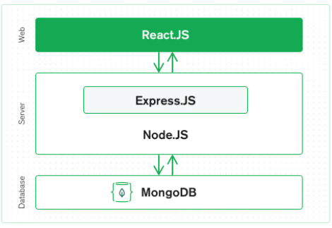

Technologies & System Architecture
MERN stack
Mongo DB: Backend database
Express JS: Framework for Node.js
React: front-end JS library for UI components
Node JS: back-end JS run time environment which runs JS codes
I decided to go with a MERN stack as I am planning on developing a web application
There is also a demand for web developers and MERN is a very popular technology stack that is used

Slide 4
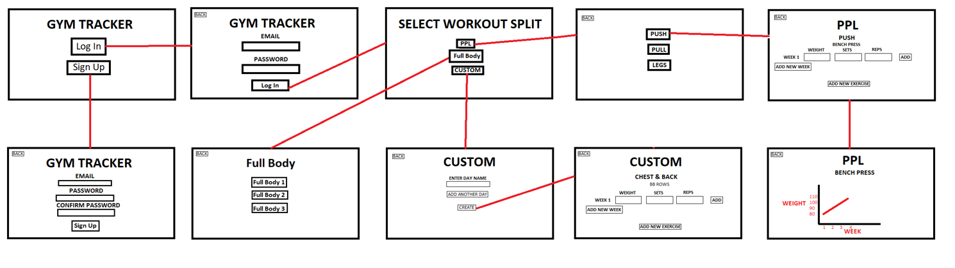
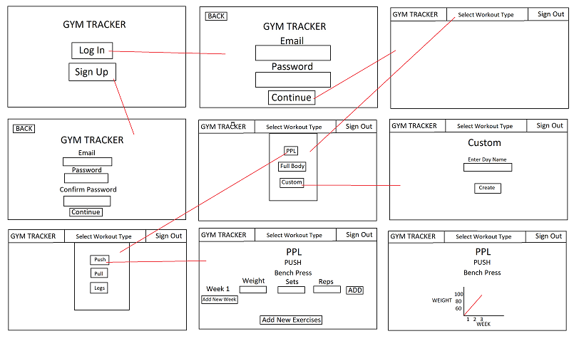
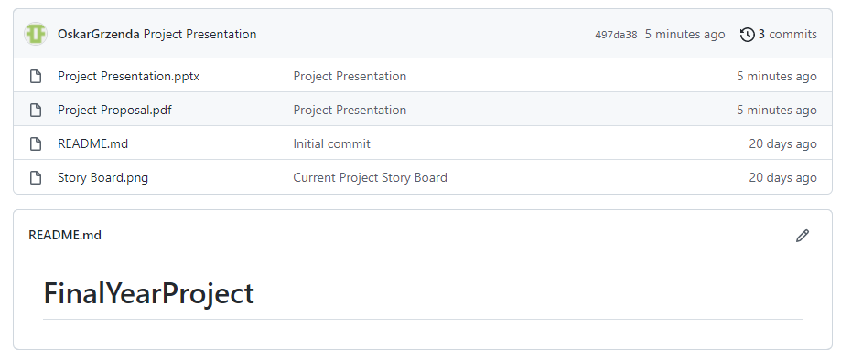
Development & Deployment
Objectives Implemented
Wireframe
Github repository
Project Dissertation

Slide 5
Work Plan
Show a Gantt Chart of the set of remaining activities.
Don’t forget to include your dissertation document and any other deliverables.

